Slide 1


Cross Platform Application Development
EquiSplit

Slide 2
Team 5
Batch – 2YB
Paresh Brahmankar
2022SP93036
Rohit Patil
2022SP93039
Rushikesh Kadam
2022SP93040

Slide 3
EquiSplit Your Ultimate Expense Splitting Companion!
Embarking on group adventures, whether it's a weekend getaway, a dinner with friends, or a collaborative project, is undeniably thrilling. Yet, managing shared expenses can often become a labyrinth of confusion and awkwardness. Enter ExpenseSplitter, the solution designed to streamline the process of splitting expenses within groups effortlessly.

Slide 4
Tech-Stack
Frontend:
React- native: React Native stands out for cross-platform frontend development due to its efficiency in various aspects. It allows developers to write code once and deploy it across multiple platforms, reducing time and effort. Leveraging native components, it ensures near-native performance, providing users with a smooth and familiar experience. Supported by a robust community and ecosystem, React Native offers a wide array of libraries and resources. This framework also contributes to cost efficiency by streamlining development for both iOS and Android. Additionally, its hot reloading feature allows real-time updates during development, accelerating iteration cycles and enhancing productivity.

Slide 5
Tech-Stack
Backend :
Node js: Node.js serves as an optimal backend solution due to its multifaceted advantages. By enabling the use of JavaScript for both frontend and backend, it streamlines development processes, reducing complexity. Its event-driven, non-blocking I/O architecture ensures scalability and high performance, handling numerous concurrent connections adeptly. Node.js benefits from an extensive ecosystem via npm, facilitating easy integration of various modules and tools, accelerating development speed. Moreover, its V8 engine offers swift code execution, enhancing application speed and responsiveness. With its lightweight nature conducive to microservices architecture and the backing of an active community, Node.js stands out as a versatile and efficient choice for backend development.
Database:
Mongodb: MongoDB Atlas offers a fully managed cloud database service with automated scalability, global distribution, stringent security, flexible data models, and integrated real-time analytics.

Slide 6

Features
Intuitive Expense Tracking
Smart Group Balancing
Real-time Updates
User-Friendly Interface
History and Insights

Slide 7



Architecture
Authentication
service
NodeJS Server
(Render platform)
MongoDB ATLAS
Express router APIS
Mongoose Conn
React Native Platforms

Slide 8
Backend
Payment graph(groupId)
User Table
User service
Group service
Group Table
uid
userdata
gid
List<User>, metadata
Expense service
Expense Table
gid
List<Expenses>

Slide 9
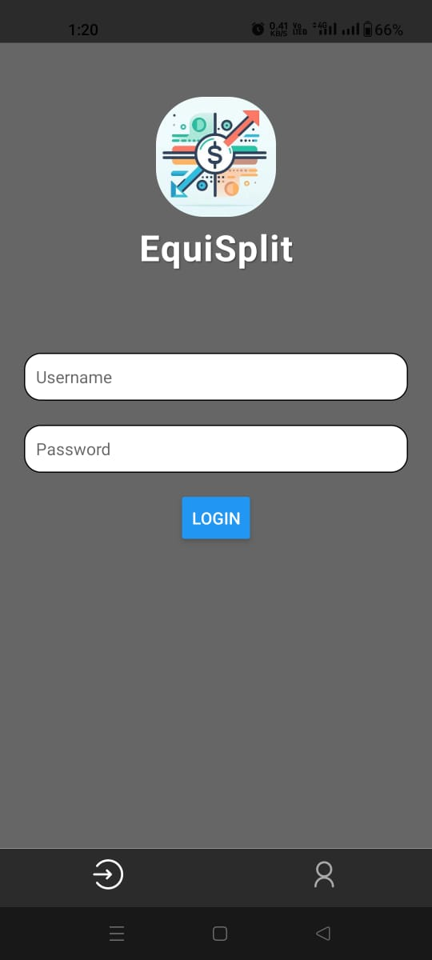
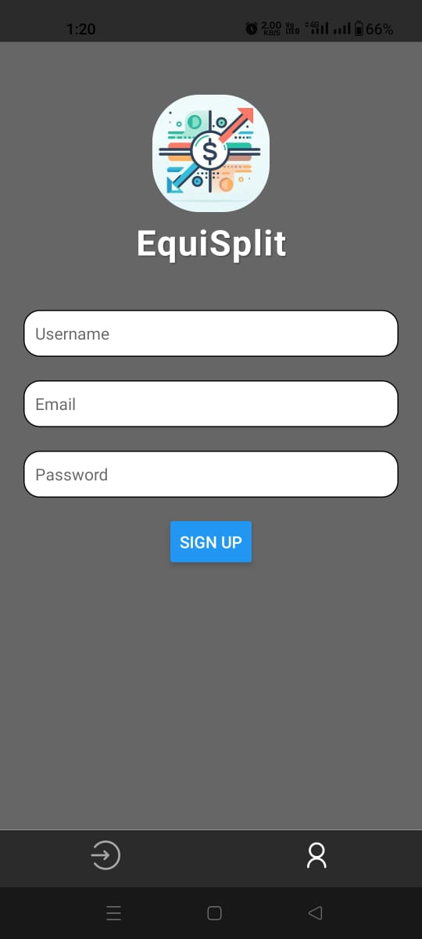
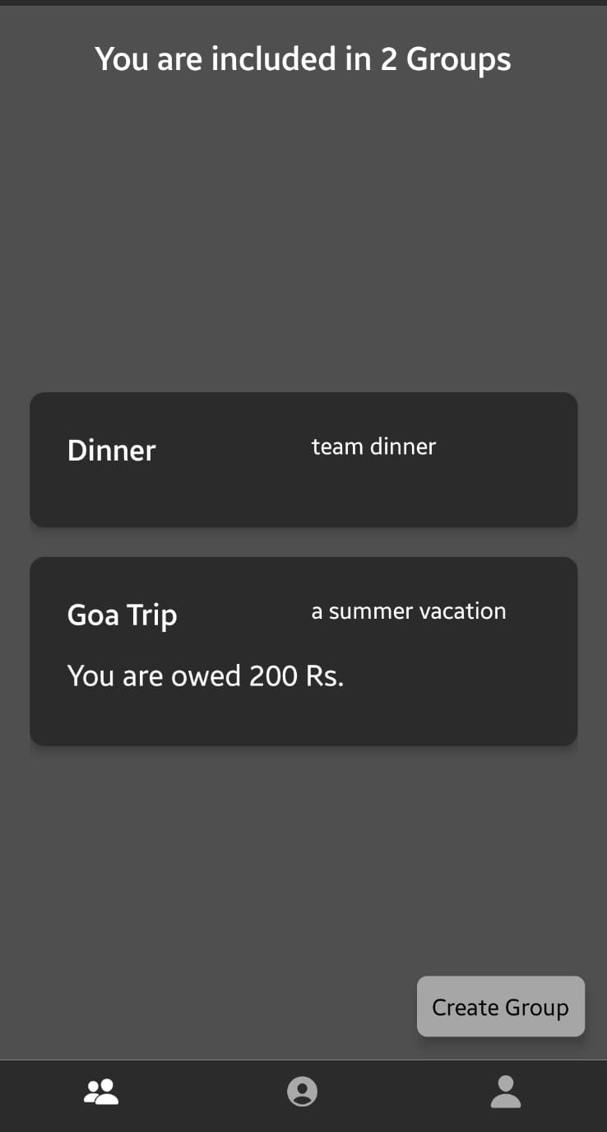
Workflow
Login
Sign-up
Home screen

Slide 10
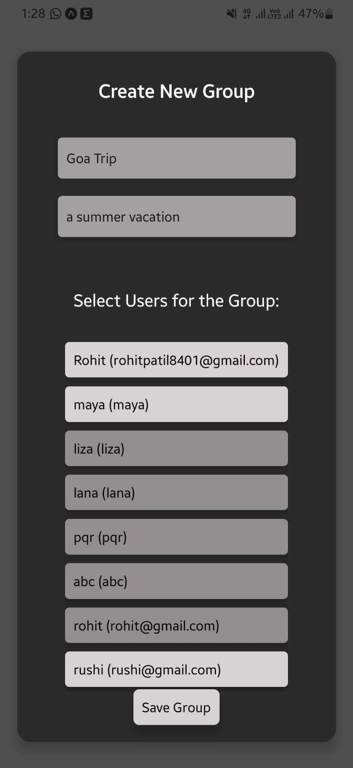
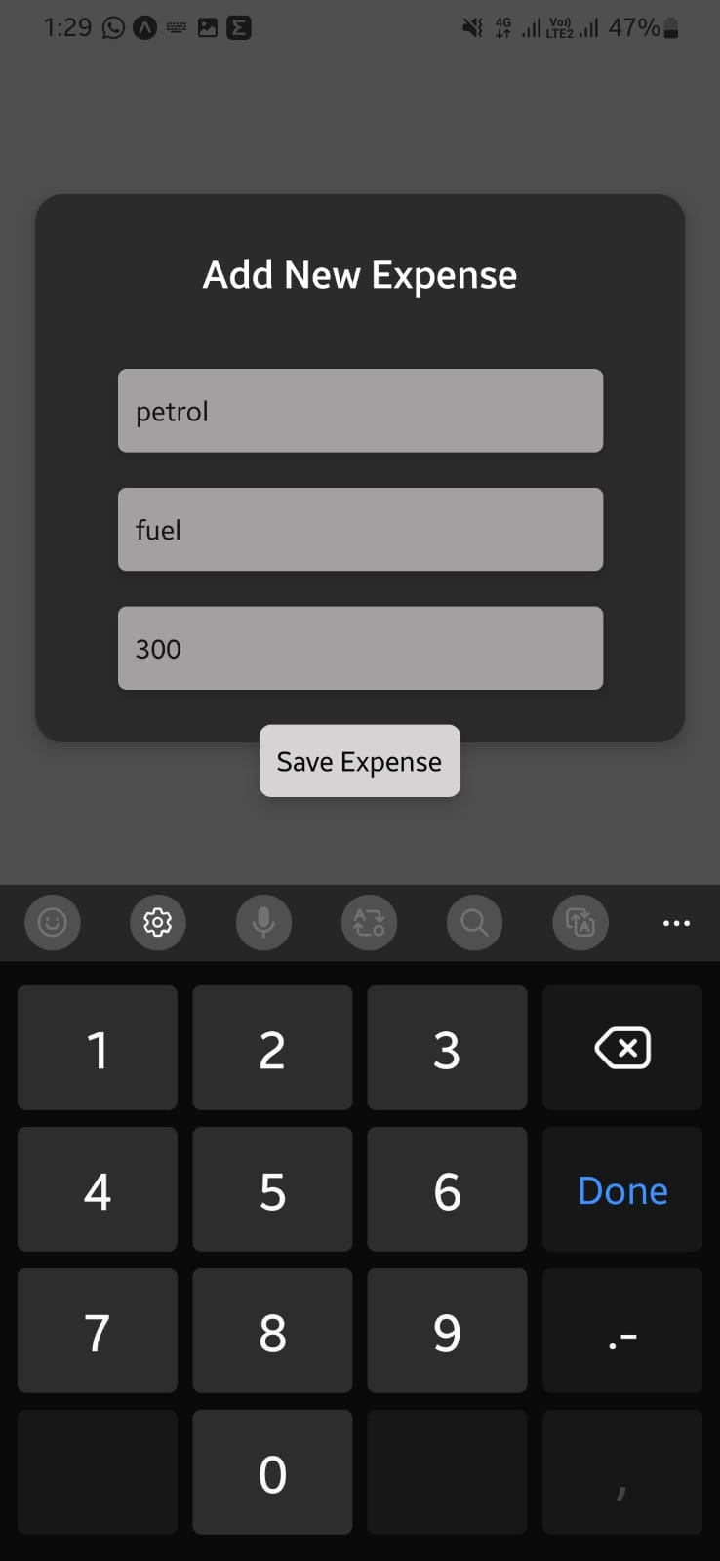
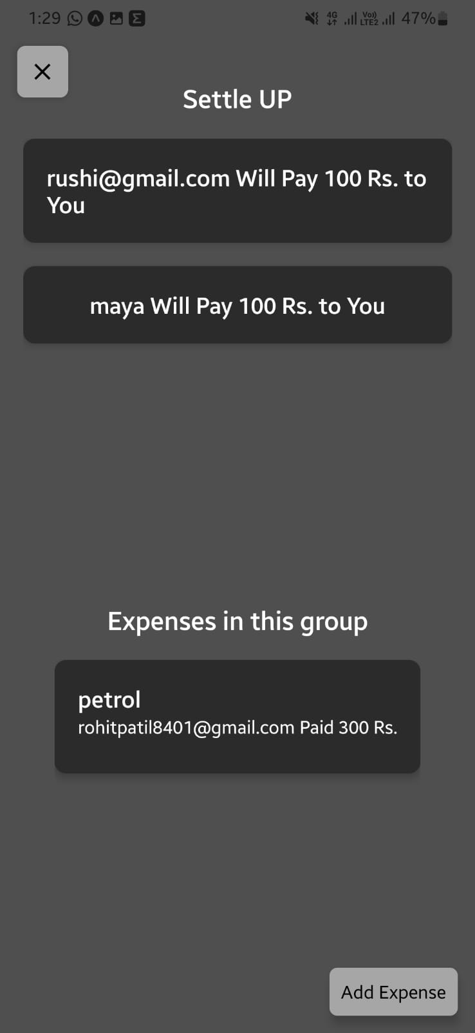
Workflow
Create Group
Add Expense
Payment Graph and expenses

Slide 11
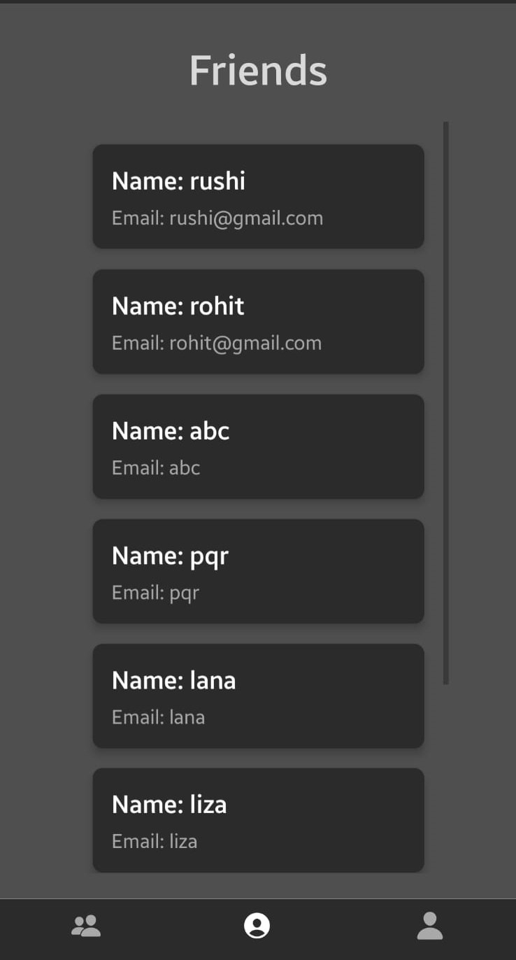
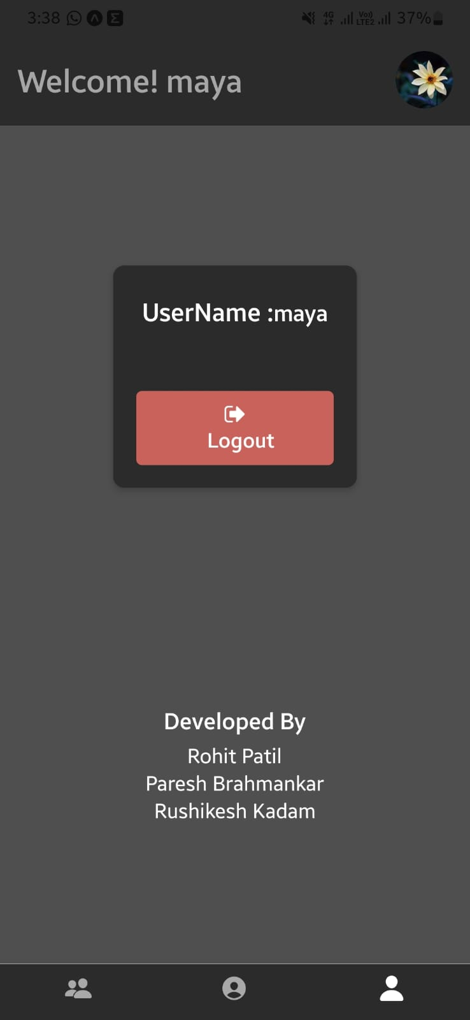
Workflow
List of Friends
Profile & Logout

Slide 12

Thank You

